Slide 1
Wireless Communication Systems and Security
CMPEN 462
Spring 2026
Mahanth Gowda
Dept. of CSE, School of EECS

Slide 2
Course Logistics Course Theme Some Assorted Thoughts

Slide 3
Course Logistics

Slide 4
Welcome to CMPEN 462
Timings: T/R 9:05 to 10:20am
Location: Waring Hall 129
Instructor: Mahanth Gowda
PhD from UIUC (Illinois), MS from Duke
Research in Wireless Networks, Mobile Computing
Email me at mahanth.gowda@psu.edu
(cc both TAs on all emails for timely responses)
Some of the material adopted from UIUC developed by Prof. Romit Roy Choudhury

Slide 5


CMPEN 462: Teaching Assistants
Shawn Li
(CSE PhD student)
zkl5382@psu.edu
Office hours:
TBA
Michael Liu
(CSE PhD student)
rml6043@psu.edu
Office hours:
TBA

Slide 6
462: Course Logistics
Prerequisite: Probability, Programming, Networking … (actually, you just need to be eager to learn)
Grading:
Homeworks: 18%
Programming Assignments: 27%
Mini Project 25%
Final Exam 25%
Class Participation 5%
Course Website:
http://www.cse.psu.edu/~mkg31/teaching/cmpen_462_sp26/
Please check course calendar frequently

Slide 7
462: Course Logistics
Programming Assignments
Any programming platform is fine
MATLAB, Python, C++
Java acceptable, if you have no other option ☹
Mini project
Still debating on whether to assign K topics
Or allow you to choose topics …
Depends on how things go

Slide 8
Course Theme

Slide 9
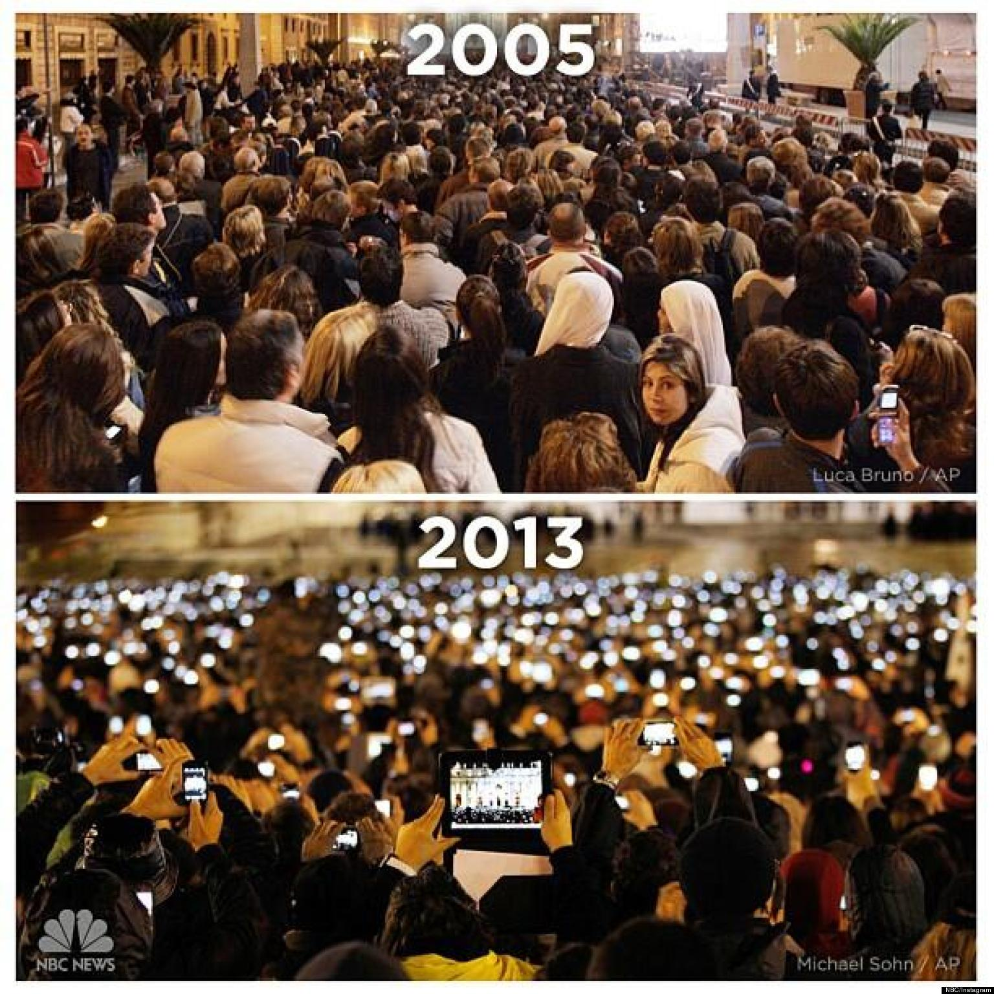
Wireless is like Electricity …
More recently

Slide 10
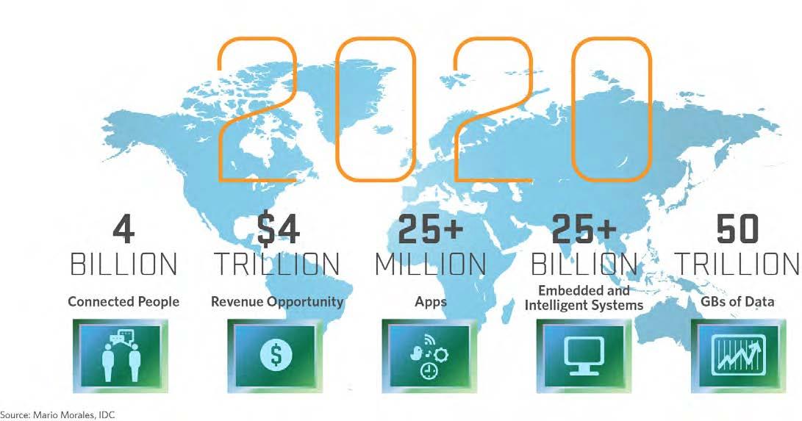
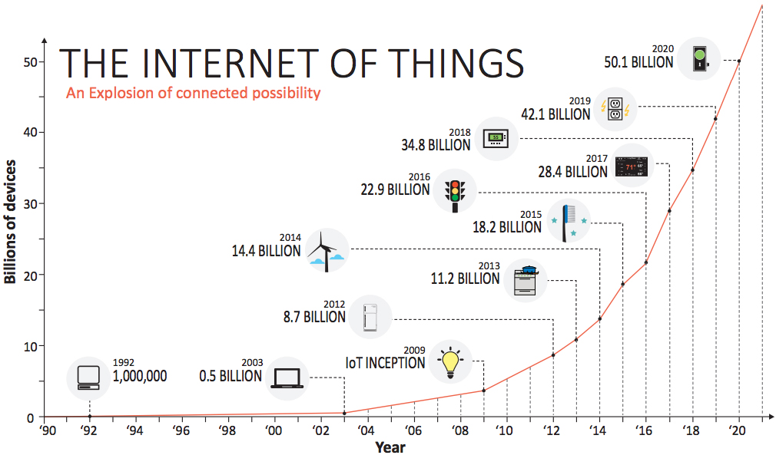
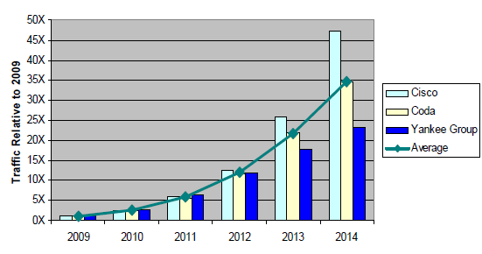
Staggering Growth …

Slide 11
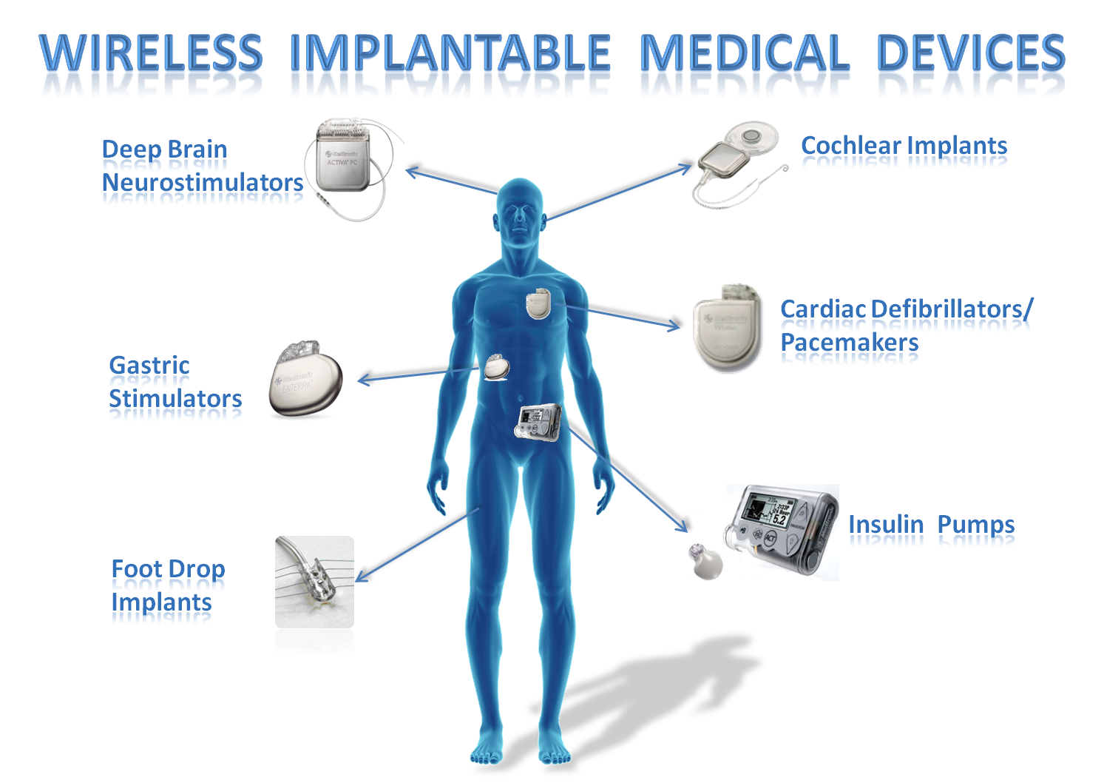
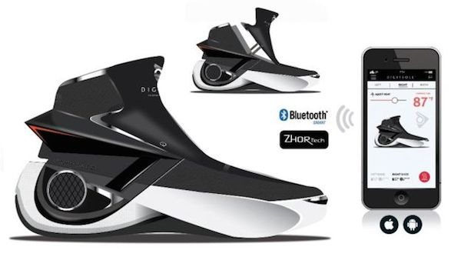
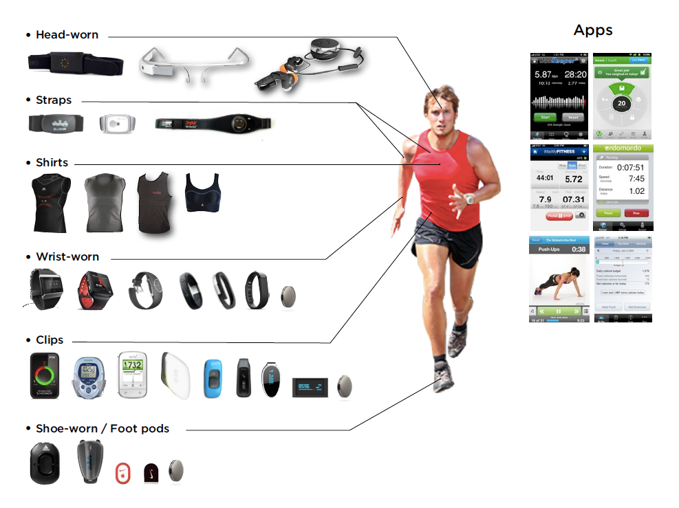


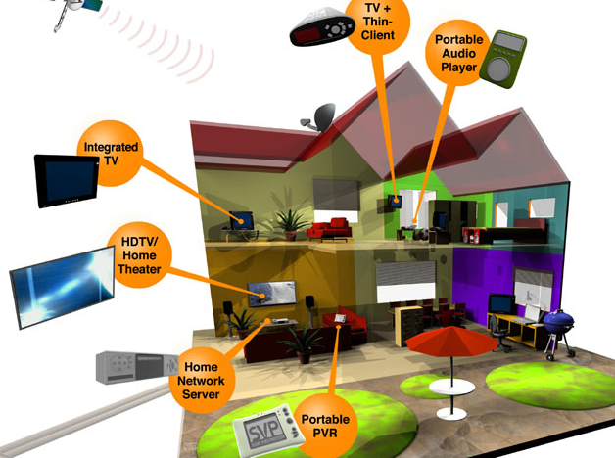
Applications Permeate All Industries …
Wireless Biomedical Implants
Cellular Networks
Wireless Wearables
Wireless Homes
Wireless Sensors
UAVs
Wireless Data Centers
Wireless VR
Wireless Vehicles

Slide 12

Obviously, this course cannot teach you all of that …
Instead, 462 will teach you the building blocks needed to
Understand modern technologies …
Take on advanced topics …

Slide 13
This Course is Not About …
Knowing information
Such as what WiFi works … and what BLE does ...
Nor is it a course in core communications
Instead, its about knowing principles and concepts
That you can apply to understand technologies (WiFi, BLE, etc.)
That you can use as a platform to learn more

Slide 14
Course sampler
30 lectures in 30 minutes

Slide 15
Wireless Internet protocol stack
application: supporting network applications
FTP, SMTP, HTTP
transport: process-process data transfer
TCP, UDP
network: routing of packets from source to destination
IP, routing protocols
link: data transfer between neighboring network elements
Ethernet, 802.11 (WiFi), PPP
physical: bits “on the wire”
application
transport
network
Link (MAC)
physical

Slide 16
PHY layer in networking is analogous to roads in transportation
100010001
Synchronization, modulation, beamforming, OFDM, MIMO
From the core of modern LTE/WiFi/BLE designs

Slide 17
Collision
Collision

Slide 18
MAC protocol in networking is analogous to signaling between cars to share a common space
Aloha, TDMA, CDMA, FDMA, OFDMA etc

Slide 19
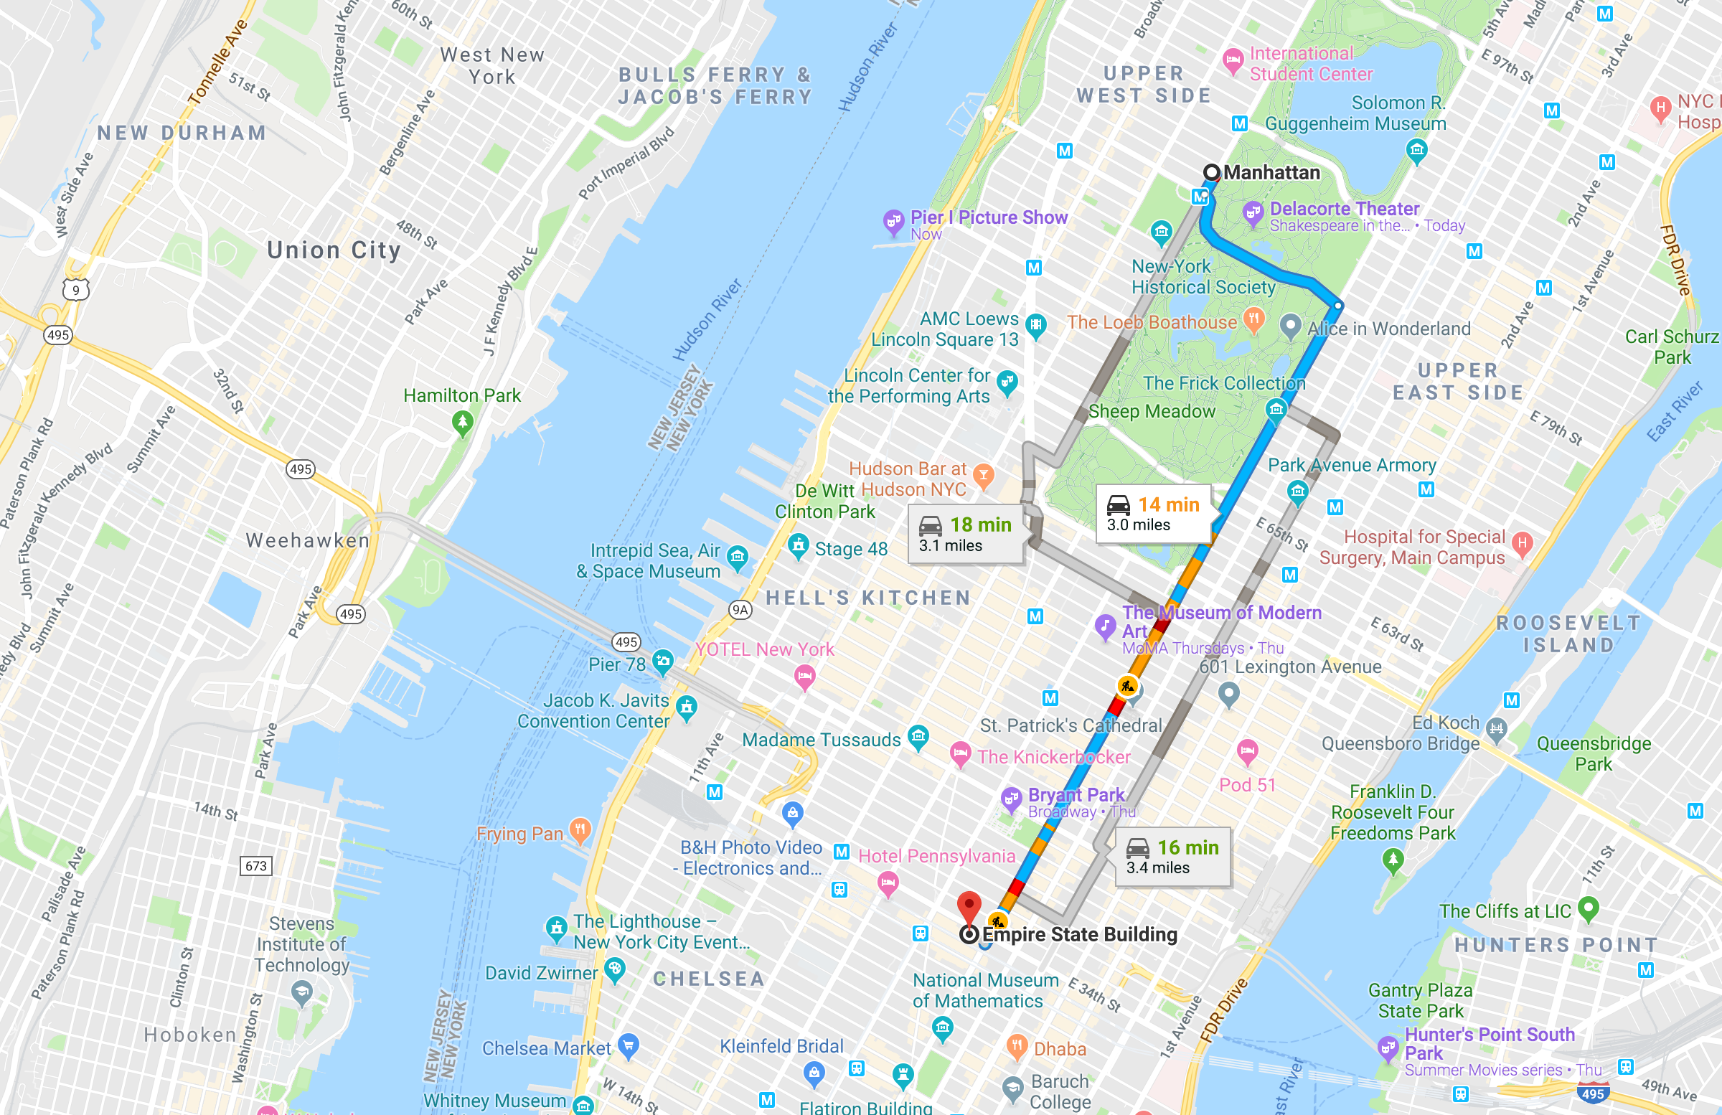

Slide 20
Routing in wireless networks
Destination
Source

Slide 21
Routing in wireless networks
Destination
Source

Slide 22
Routing in wireless networks
Destination
Source
Choose best route based on metrics such as energy, latency, throughput etc.

Slide 23
Transport (TCP over Wireless)
Wireless
Wired
Internet
TCP needs to be modified to treat wired and wireless links differently

Slide 24
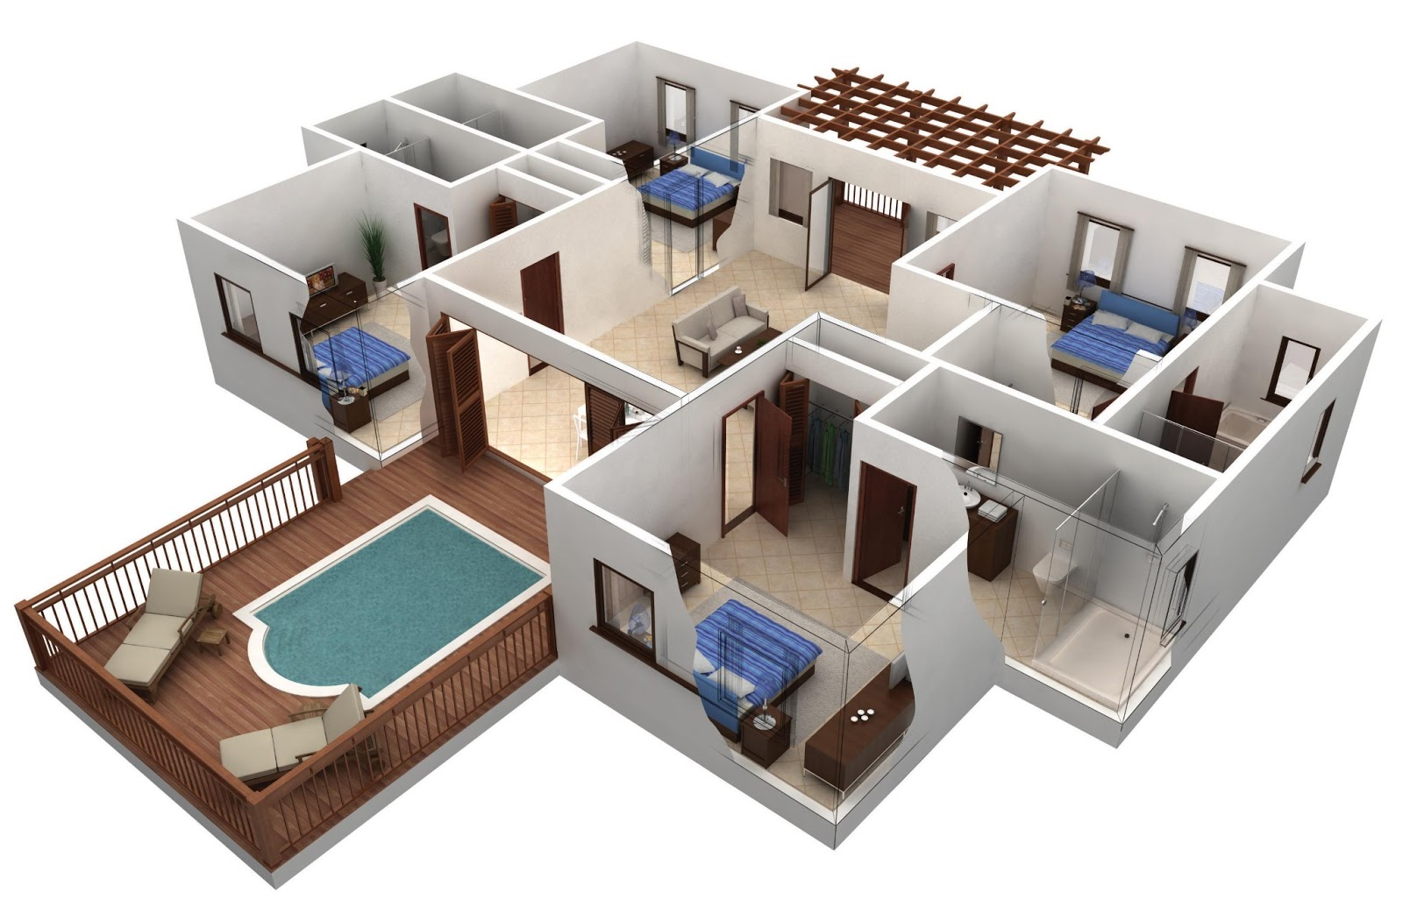


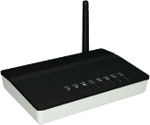
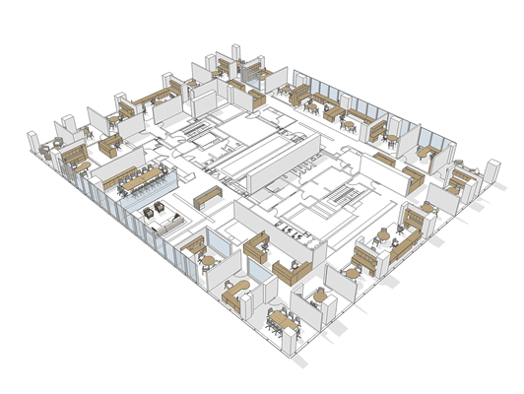
Static Infrastructure, Mobile Clients

Slide 25
What if infrastructure is also mobile?

Slide 26

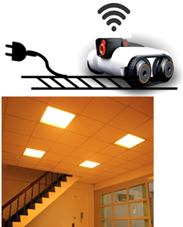
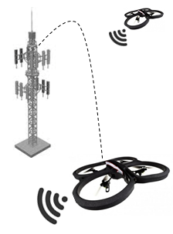


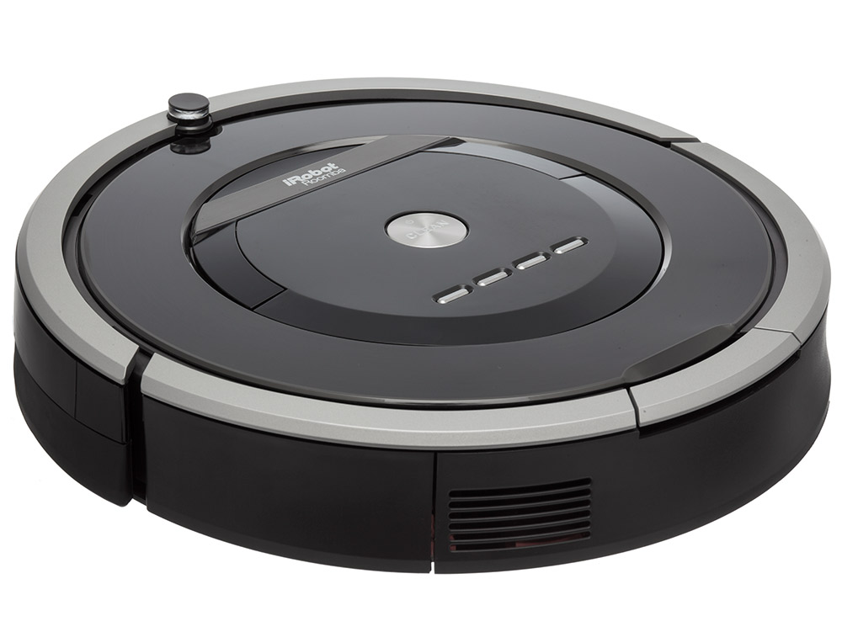
Regimes of Infrastructure Mobility
Tethered
Mobility (feet)
Ceiling Track
Mobility (meter)
Cell Tower Relays (km)
Mobility Range

Slide 27
5G and mmWave networking

Slide 28
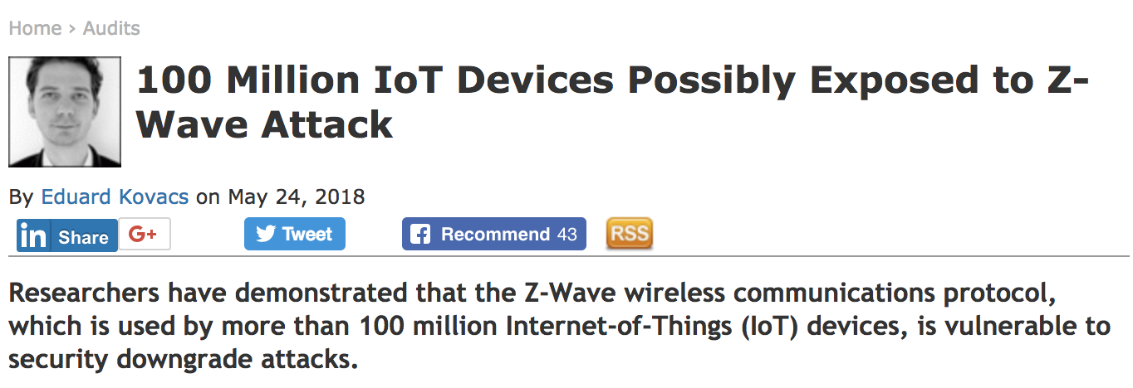
Wireless Security - IoT

Slide 29
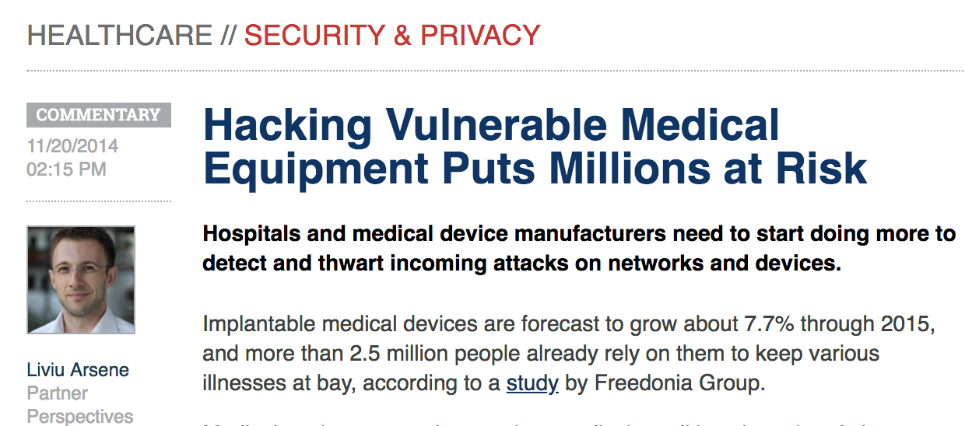
Wireless Security – Medical devices

Slide 30

Wireless Security - Vehicles

Slide 31
Applications

Slide 32

GPS, Localization, and
Applications to Drones

Slide 33
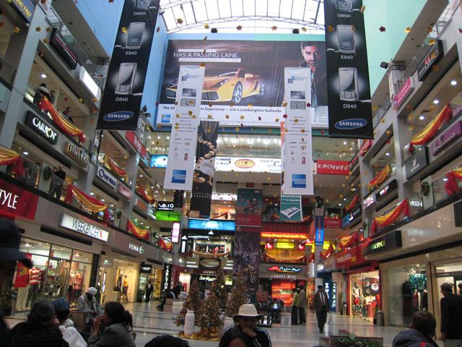
Indoor Localization

Slide 34
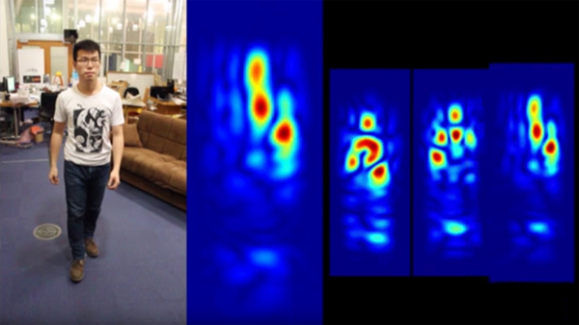
Wireless Gesture Tracking

Slide 35
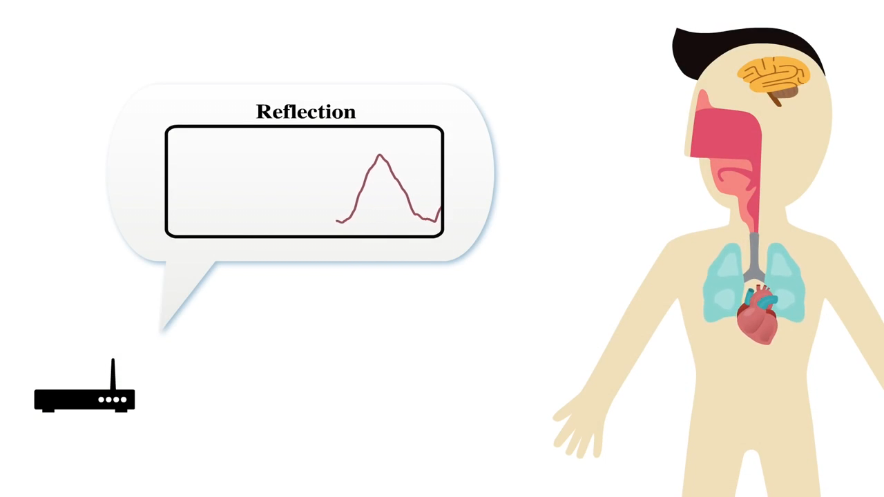
Wireless emotion detection
Happy
Sad
Angry
Mad

Slide 36

Eavesdropping and Spying

Slide 37
Course Content (see webpage)
Basics of linear algebra, probability, and signal processing
Physical layer techniques - Synchronization, modulation, wireless channel
Physical layer techniques - OFDM/MIMO/Beamforming - in LTE/WiFi
Coordination mechanisms and MAC protocols for multi-user network access
Robotic wireless networks (robots, drones carrying access-points and cell towers)
Network routing (adhoc, mesh, and sensor networks)
Transport protocols (TCP over wireless)
mmWave networks and 5G
Energy efficiency and battery free communication
Sensing (Human gestures, imaging objects) and localization
Security (physical channel as encryption key, radio fingerprinting, location spoofing)

Slide 38
Some Assorted Thoughts

Slide 39
Assorted Thoughts: Math
We will need some math …
But we will start from absolute scratch ... no, I mean it
And the math should be useful in many many other contexts

Slide 40
Assorted Thoughts: Math
Top-down vs. Bottom-up
Most math taught bottom-up ...
Great for those who will work with math ...
But hard for those who will use math
Teaching math top-down is hard
Far slower to make progress
But what you understand is much clearer ...
Since you know why you care about the tool
This course will try to balance ...

Slide 41
Assorted Thoughts
Of course, lots of other stuff
Core concepts and ideas in networking
Algorithms
Making connections between different ideas
Programming
Building / Appreciating a complete end to end system
Like building a structure from lego blocks

Slide 42
Assorted Thoughts
This class is about exciting topics
Be active, ask questions, debate, and disagree

Slide 43
Assorted Thoughts
This class is about exciting topics
Be active, ask questions, debate, and disagree
Read a lot – this is a hot research area
If you are hunting for a research area, or passionate on start-ups, jobs in IoT industry, read even more

Slide 44
Assorted Thoughts
This class is about exciting topics
Be active, ask questions, debate, and disagree
Read a lot – this is a hot research area
If you are hunting for MS/PhD area, or passionate on start-ups, read even more
Interact with me
Even if you have ZERO clue of what’s going on

Slide 45
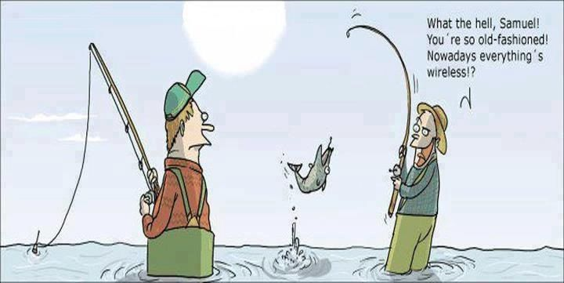
Questions?

